Slide 1
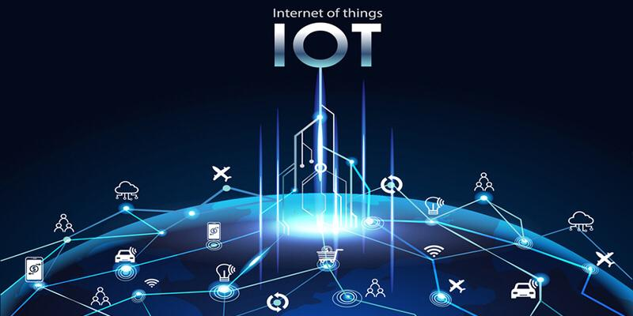

Slide 2

Agenda
Introduction to IOT
IOT Definition
Expected Numbers of IoT devices or “objects”
IOT Characteristics
IOT Applications
IOT Advantages and Disadvantages
IOT Challenges
IOT Security

Slide 3
Introduction to IOT
-Imagine a world in which every device in the home. workplace and car connected.
-A world where the lights automatically turn on when the car approaches the driveway.
-The coffee starts brewing when the morning alarm goes off and the front door automatically unlocks when approached by a member of the household, but stays locked when a stranger arrives on the front step.
That is the type of world the Internet of Things can create.....

Slide 4
IOT Definition
-Internet of Things (IoT) :
is the integration of objects with the world of the internet, by attaching hardware (sensors) or/and software to make these objects smart and so be able to communicate with each other and participate effectively in all aspects of daily life.

Slide 5
IOT Definition
Internet of Things (IoT)
is the concept of connecting any device with an on and off switch to the network of internet to make it able to communicate with other devices and objects within this network.
-This includes everything like cellphones, coffee makers, washing
machines, headphones, lamps and almost anything else you can
think of. This also can be applied to components of machines, for example a jet engine of an airplane.

Slide 6
Expected Numbers of IoT devices
There are over 12 billion devices that can connect to the internet, and that number is
grow past 14.2 billion by the end of 2019
The analyst firm Gartner says that by 2020 there are over 26 billion connected devices
There will be 41.6 billion connected IoT devices, or “things,” by 2025
2019
2020
2025

Slide 7
Agenda
Introduction to IOT
IOT Definition
Expected Numbers of IoT devices or “objects”
IOT Characteristics
IOT Applications
IOT Advantages and Disadvantages
IOT Challenges
IOT Security

Slide 8
IOT Characteristics
Ambient Intelligence
Event Driven
Semantic Sharing
Complex Access
Technology
Flexible Structure

Slide 9
IOT Characteristics
• Ambient intelligence
-AMI refers to electronic environments that are sensitive and responsive to the presence of people
-The independent & intelligent entities will act in full interoperability & will be able to auto-organize themselves depending on The context, circumstances or environment

Slide 10
IOT Characteristics
• Event Driven
is to design the scheme depending on the need
• Flexible Structure
means that hundreds and thousands of nodes will be disable and will be set to run

Slide 11
IOT Characteristics
•Complex access technology
means that there's several kinds of media such as vehicle stone that they need different access technologies.
• Semantic Sharing
is the machine can rend and send by themselves. No need to tell human beings

Slide 12
IOT Applications
Education
Management
Food
Retail
Health Care
logistics

Slide 13
IOT Advantages
Dynamic control of industry & daily life
Improve the resource utilization ratio
Integrating human society & physical systems
Flexible configuration
Universal transport & internetworking
Acts as technologies integrator

Slide 14
IOT Disadvantages
safety
complexity
Security
compatibility

Slide 15
Agenda
Introduction to IOT
IOT Definition
Expected Numbers of IoT devices or “objects”
IOT Characteristics
IOT Applications
IOT Advantages and Disadvantages
IOT Challenges
IOT Security

Slide 16
IOT Challenges
• Sensing a complex environment
Innovative ways to sense and deliver information from the physical world to the cloud
• Connectivity
Variety of wired and wireless connectivity standards are required to enable different application needs

Slide 17
IOT Challenges
• IOT is complex
IOT application development needs to be easy for all developers , not just to exports
• Cloud is important
IOT applications require end-to-end solutions including cloud services

Slide 18
Agenda
Introduction to IOT
IOT Definition
Expected Numbers of IoT devices or “objects”
IOT Characteristics
IOT Applications
IOT Advantages and Disadvantages
IOT Challenges
IOT Security

Slide 19
IOT Security
-What do we mean by IoT Security?
IOT security is the technology are a concerned with
safeguarding connected
devices and networks in the
internet of things.

Slide 20
IOT Security
-Why do we need IOT security?
Encryption can help prevent unauthorized access
to data and devices. This helps maintain data
integrity and prevent data sniffing by hackers so
you must use Authentication.
All communication with your IOT devices should
be authenticated using strong passwords,
authentication protocols or time-based
authentication tokens.

Slide 21
IOT Security
-Problems and security challenges
Need new devices for endpoint security, new firewalls, embedded OS, new software & etc.
It is not possible to support AV (anti-virus) on every device.
Need new transport protocols for making network security difficult.
Applying security analysis leads to much more network traffic.
Bad news for large enterprises as network security is already complex and complicated for most of enterprises.

Slide 22
IOT Security
-IOT will merge the following domains
Information Security
Information Technology Security
Physical Security
Operational Security

Slide 23
IOT Security
-How do you secure an IOT solution?
Create more effective and secure
password policies.
Use IOT PKI Security Methods.
-To ensure a secure connection between an IOT device & app, use IOT public key infrastructure security methods cryptographic key.
Authenticate the IOT Devices.
-Allow the users to authenticate the IOT devices.

Slide 24
IOT Security
-How do you secure an IOT solution?
Secure the IOT Network.
-Protect and secure the network connecting IOT devices
by implementing traditional endpoint security features
such as antivirus, anti-malware, firewalls.
Use encrypted protocols to secure communications.
-To protect the privacy of users and prevent IOT data
breaches, between IOT devices and back-end systems by using standard cryptographic algorithms.

Slide 25
Questions…?
Thank you
Nourihan Nawrey

